Slide 1

PSO & GA
OPTIMIZATION LAB
2021-12-17

Slide 2


Content
NumPy Arrays review (again).
Velocity Update Equations.
PSO – The End.
Introduction to Genetic Algorithm.

Slide 3
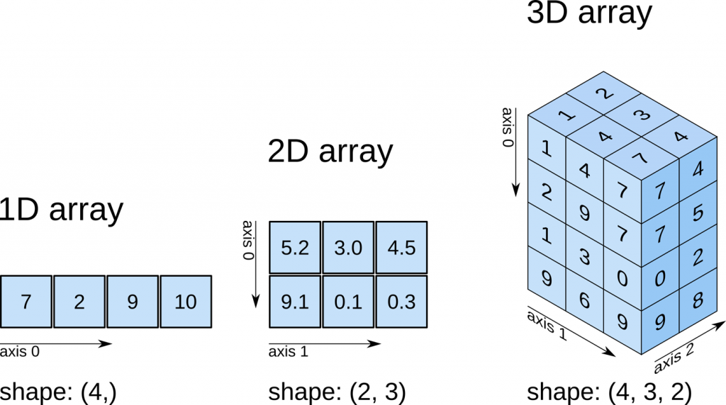
N-dimensional arrays indexing

Slide 4


Velocity Update Equations - Vmax

Slide 5
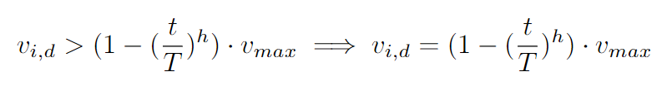
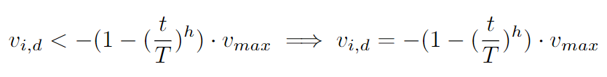
Velocity Update Equations – Fan Modified

Slide 6
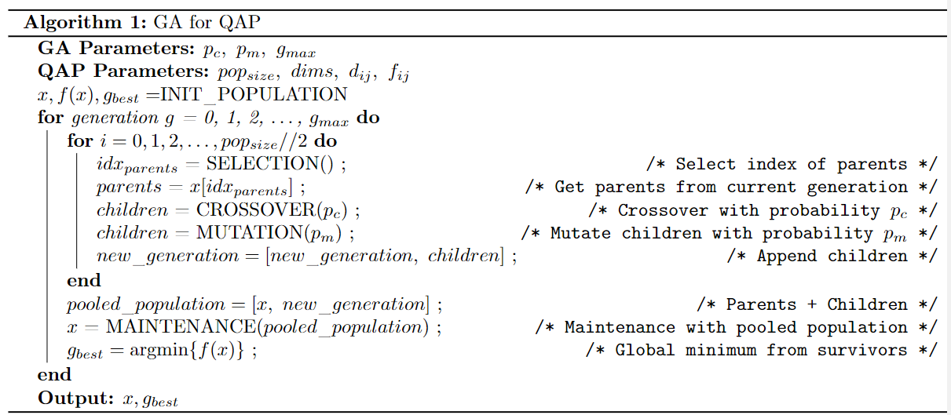
Genetic Algorithm

